Slide 1
Meta-DPI: A Computational Metamethod for Predicting Protein-Protein Interfaces
Mordechai Walder
Evan Edelstein
March 12th, 2020

Slide 2
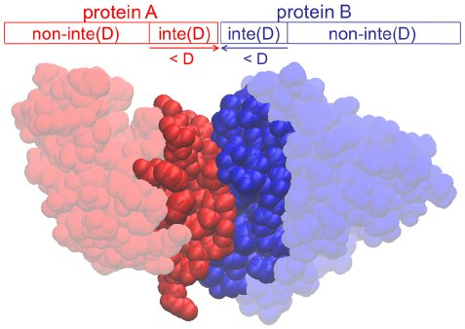
What is a Protein-Protein Interface (PPI)?
When two proteins form a complex, the site at which binding occurs is the PPI
The binding interface of protein A is the cluster of amino acid residues that participate in binding with protein B
A residue is classified as being at the interface if one of its atoms is within a threshold distance D from the binding partner
Determining a protein’s binding interface is critical to understanding the function of the protein

Slide 3
Significance of PPI
Many biological processes are regulated by interactions between proteins
Membrane transport
Signal transduction pathways
Metabolic pathways
Protein modifications at a PPI can disrupt the interaction or promote it
Many disease-causing mutations are found at PPIs because they disrupt a protein complex involved in a critical cellular process
Protein binding inhibitors can serve as potential therapeutic drugs

Slide 4
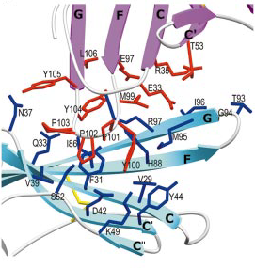
Ipilimumab: therapeutic treatment that targets a PPI
The binding of CTLA4 to CD86 on dendritic cells downregulates the T cells immune response
Ipilimumab is a monoclonal antibody that binds to CTLA4 and prevents it from binding to CD86
Ipilimumab has been approved by the FDA
CTLA4-CD86 Binding
NATURE |VOL 410 | 29 MARCH 2001
Notes:
Cytotoxic T lymphocytes can destroy cancerous cells when their antigens are presented by dendritic cells
When the protein receptor CTLA4 binds to the CD86 protein on dendritic cells, it transmits an inhibitory signal to the T cell that downregulates its immune response
which allows the uninhibited T cells to destroy cancerous cells

Slide 5
Identifying residues at PPI
Experimental Methods: X-Ray Crystallography, NMR Spectroscopy, Cryo-Electron Microscopy, & Alanine Scanning Mutagenesis
Experimental approaches can be labor-intensive and time-consuming
Despite the fact that a protein will interact with 3-10 other proteins on average, the Protein Data Bank contains a disproportionally small fraction of known protein complexes
Computational prediction methods serve as a valuable aid in the process of identifying PPI residues
Notes:
Explain Alanine Scanning Mutagenesis & difficulty of complex crystallization

Slide 6
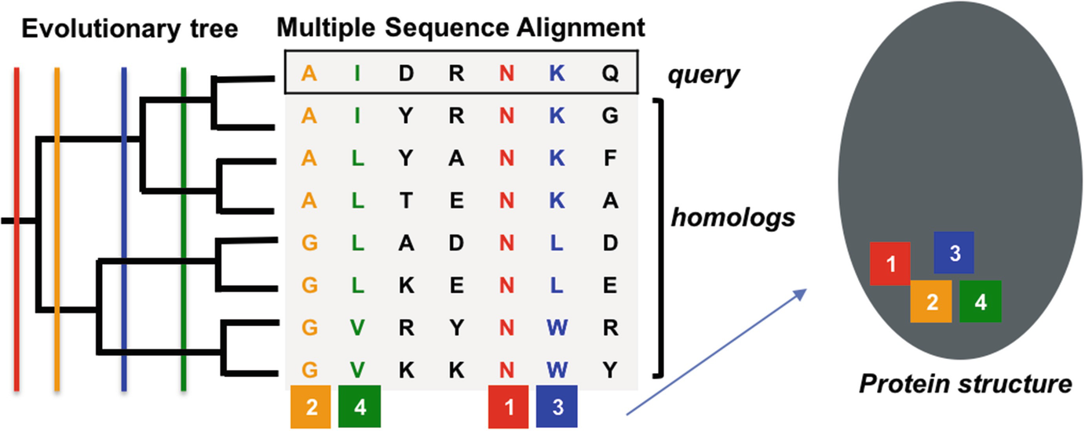
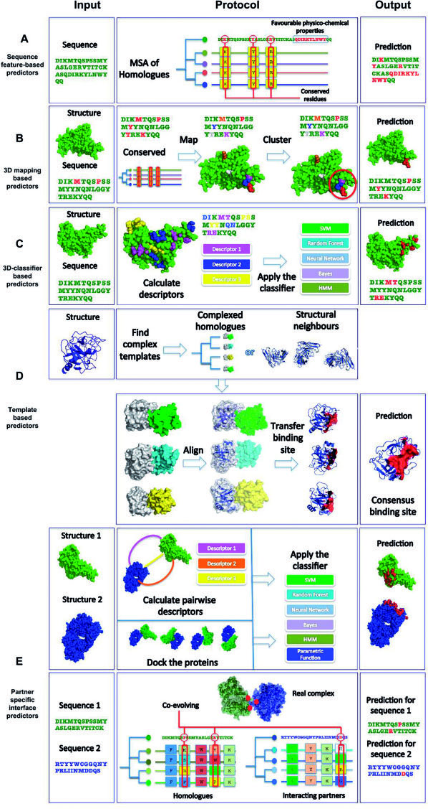
Computational methods for predicting interface residues
Template-Based Methods:
Homologous template-based predictors
Structural neighbor-based predictors
R. Esmaielbeiki, K. Krawczyk, B. Knapp, J. C. Nebel, C. M. Deane, Progress and challenges in predicting protein interfaces. Brief Bioinform 17, 117-131 (2016).
Notes:
Emphasize that only the query structure is known
Homologous template-based predictors: the query protein’s complexed homologues are found, and the homologues’ binding sites are mapped onto the query protein
Structural neighbor-based predictors: the query protein’s complexed structural neighbors (similar 3D structure) are found, and the neighbors’ binding sites are mapped onto the query protein

Slide 7
Computational methods for predicting interface residues
Intrinsic-Based Methods:
Sequence Features: evolutionary conservation and interface propensity
Structural Features: secondary structure, solvent-accessible surface area, and geometric shape
R. Esmaielbeiki, K. Krawczyk, B. Knapp, J. C. Nebel, C. M. Deane, Progress and challenges in predicting protein interfaces. Brief Bioinform 17, 117-131 (2016).
Notes:
machine-learning algorithms are trained on a dataset of proteins with experimentally determined interfaces to model how a residue’s features correlate with its likelihood to appear at the interface. The features of a query protein are analyzed by the algorithm to predict its likely interfacial residues.

Slide 8
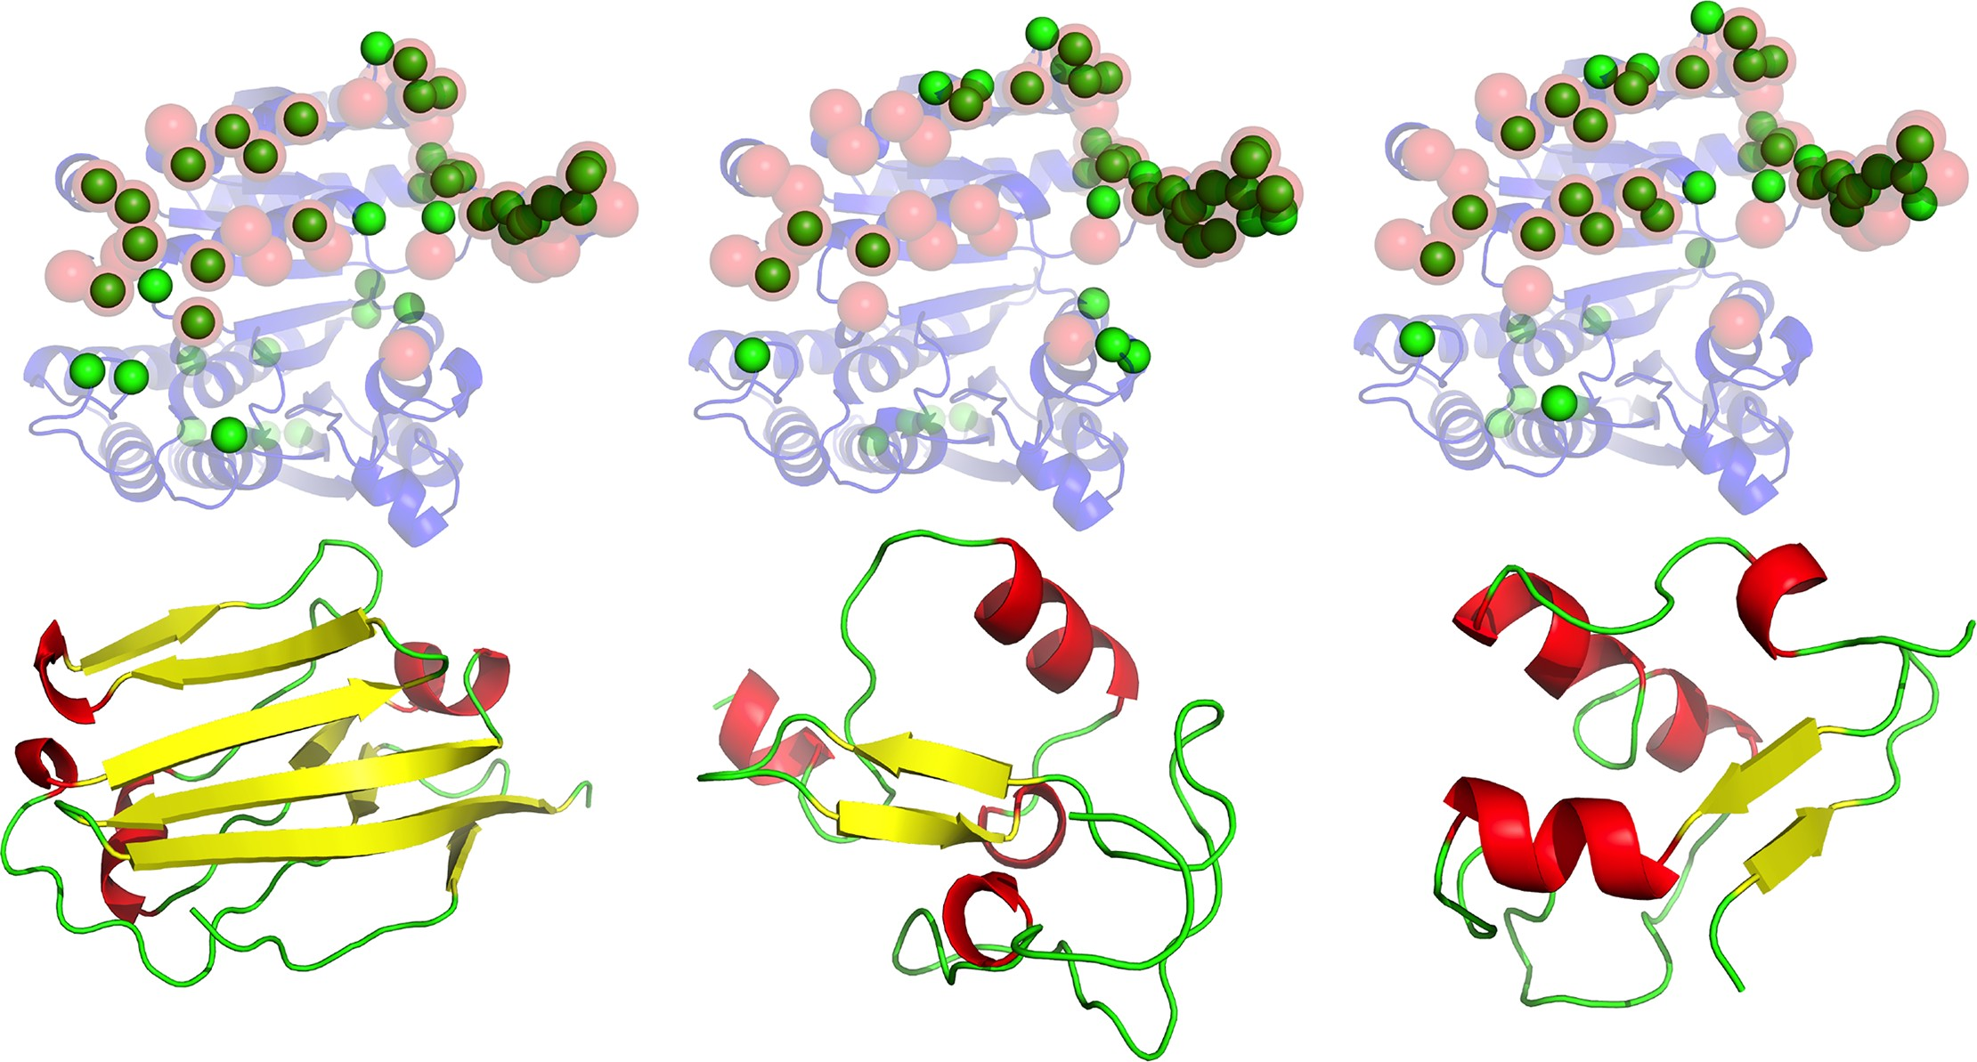
Dockpred
Small molecules (substrate and non-substrate) are known to bind to the same (“sticky”) sites on a target protein
Can this be extended to protein-protein interactions?
Viswanathan, R., et al., Protein-protein binding supersites. PLoS Comput Biol, 2019. 15(1): p. e1006704.
Notes:
Applied principle of small molecule sticky sites on proteins to protein-protein interactions
Docking program used to generate 2000 complex structures for each query protein with each of the 13 non-cognate ligand probes
For each of the complex structures, k = 1, 2000, a value is assigned for each residue R_{i} _{k}, I(R_{i} _{k}) = 0 or 1). Then a residue interface frequency (RIF), N_{i}, is determined for each residue by summing over the 2000 structures: $N_{i }= \sum_{k=1}^{2000}{I(R_{ik})}$.
Briefly explain docking

Slide 9
Limitations of Computational methods
Template-based approaches are constrained by the amount of proteins with a known complex structure
Intrinsic-based approaches are limited by the amount of features that can be used to train prediction models
Hypothesis:
Interface prediction performance can be enhanced by developing a metamethod that combines orthogonal prediction methods
meta-DPI: DockPred (docking), PredUs 2.0 (template), and ISPRED4 (intrinsic)

Slide 10
predus 2.0
Structural template-based approach
Combines amino acid interface propensity with template-based score
Uses protein structural distance (PSD) to quantify structural similarity between two proteins
Maps neighbor’s binding partner onto query protein using transformation relating the neighbor to the query
Hwang, H., D. Petrey, and B. Honig, A hybrid method for protein-protein interface prediction. Protein Sci, 2016. 25(1): p. 159-65.
Notes:
Calculated by superposing two protein structures in a manner that minimizes the root-mean-square deviation of the amino acids’ alpha carbons
A residue’s contact frequency score is weighted by the PSD value for the neighbor and query
Using a set of 2,766 heterodimeric complexes, interface propensity for each residue type r was computed based on its enrichment in relative ASA at the interface
Each query residue is assigned a score between 0 and 1 reflecting interface likelihood

Slide 11
ispred4
Intrinsic-based method
Constructs its prediction model using a set of sequence and structural features that consists of 10 different groups of descriptors
Descriptor Group: Geometric Features
Depth
Protrusion
Trains using two machine-learning models (SVM &GHRCF)
Savojardo, C., et al., ISPRED4: interaction sites PREDiction in protein structures with a refining grammar model. Bioinformatics, 2017. 33(11): p. 1656-1663.
Notes:
trained support vector machine algorithm on a dataset of 314 monomer chains

Slide 12
Meta-dpi
Developed using two sets of proteins with experimentally determined interface residues; 107 proteins from the Docking Benchmark database and 116 proteins from the NOX database
Each residue was assigned an interface score of 0 (non-interface) or 1 (interface) based on the experimental data
Prediction scores (between 0 and 1) for DockPred, PredUs 2.0, and ISPRED4 were found for all protein residues in the datasets
Amino Acid Residue Type & Position | Interface Prediction Score
a ⋮ z | 1 ⋮ 0
Notes:
The inverse process was done for Docking Benchmark proteins using the coefficients determined by training on NOX proteins
A logistic regression model was trained on the prediction scores for each set of proteins

Slide 13
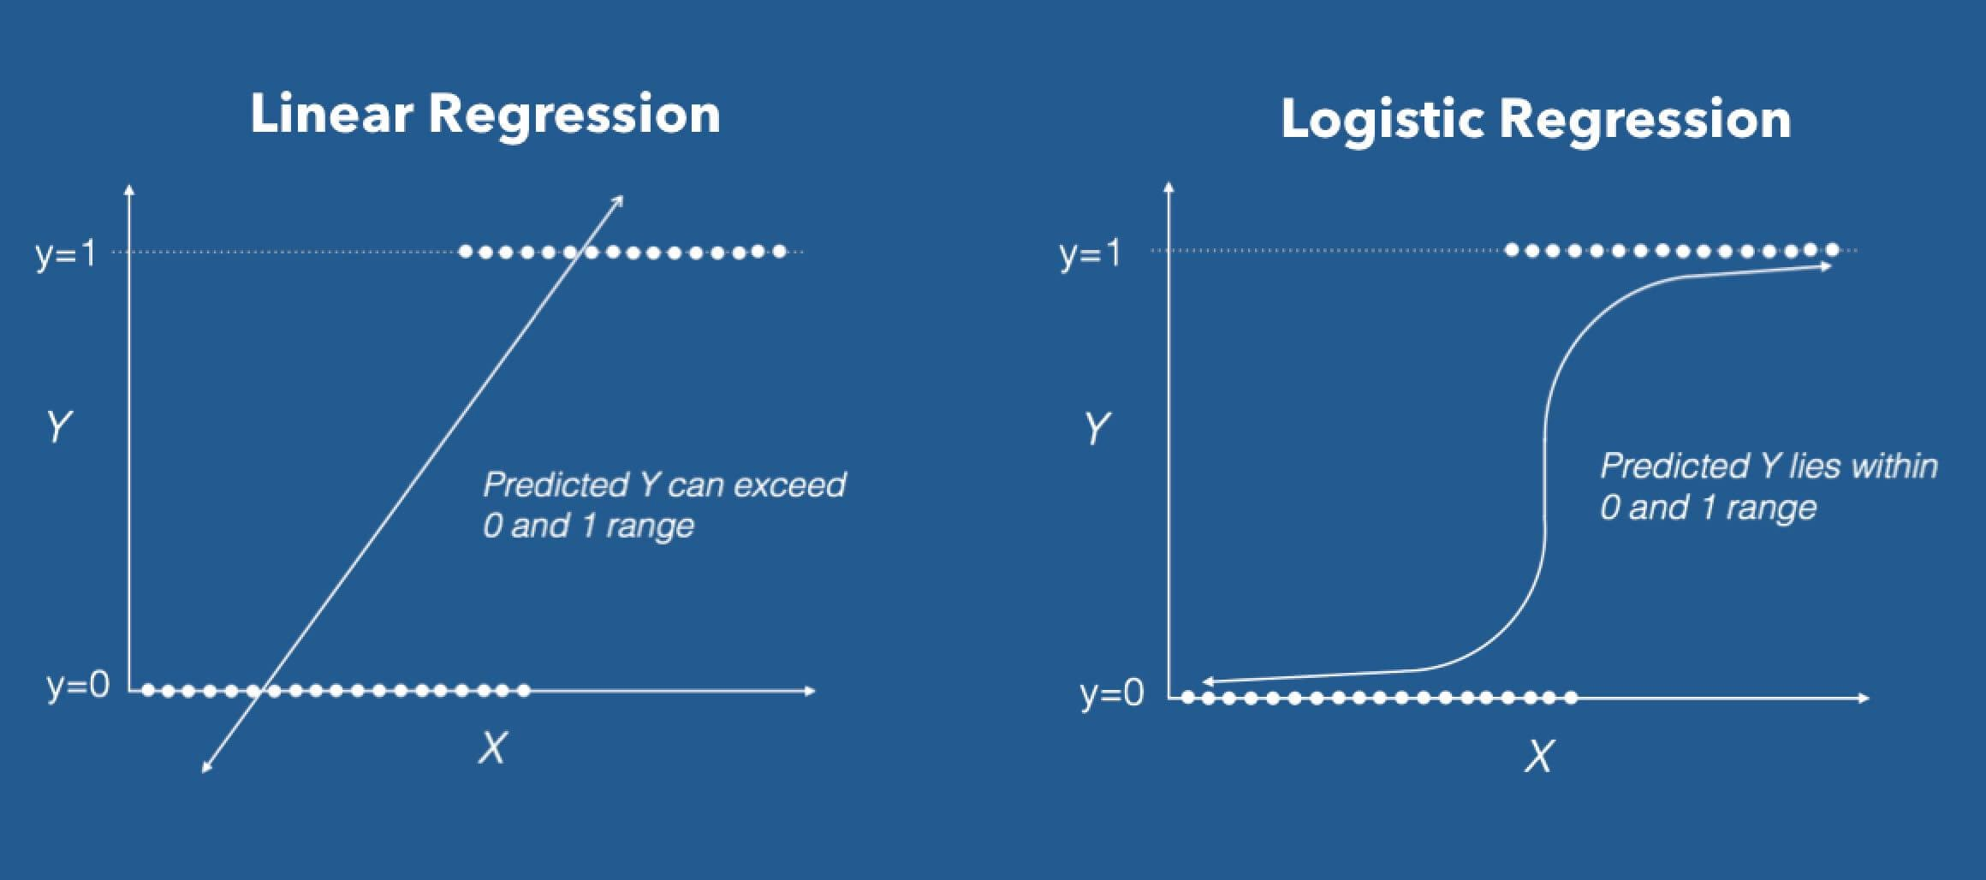
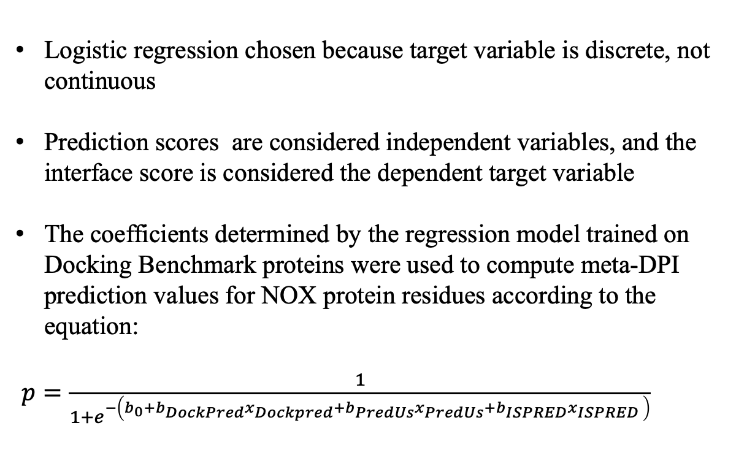
logistic regression
Logistic regression chosen because target variable is discrete, not continuous
Prediction scores are considered independent variables, and the interface score is considered the dependent target variable
The coefficients determined by the regression model trained on Docking Benchmark proteins were used to compute meta-DPI prediction values for NOX protein residues according to the equation:
$p=\frac{1}{1+e^{−\left(b_{0}+b_{DockPred}x_{Dockpred}+b_{PredUs}x_{PredUs}+b_{ISPRED}x_{ISPRED} \right)}}$

Slide 14
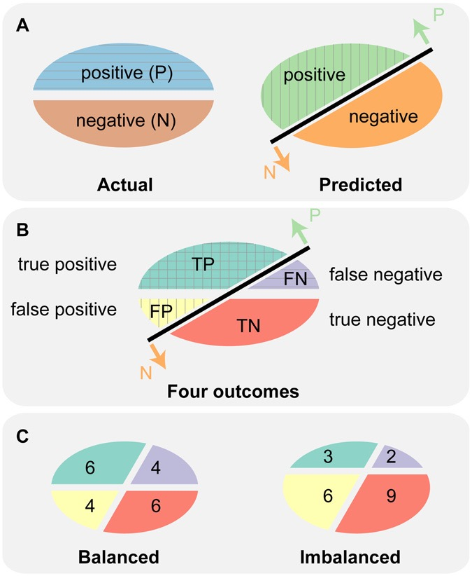
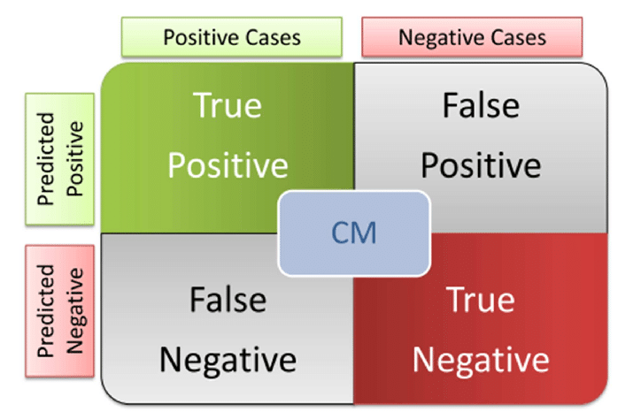
Binary classifier evaluation: Confusion matrix
Notes:
True Positive(TP): Residue predicted to be at interface is actually at interface
False Positive(FP): Residue predicted to be at interface is not actually at interface
True NegativeTN): Residue predicted not to be at interface is not actually at interface
False Negative(FN): Residue predicted not to be at interface is actually at interface

Slide 15
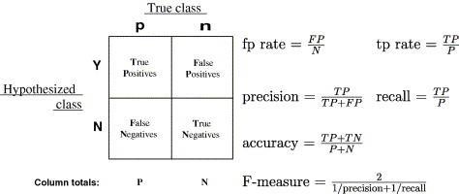

Performance metrics

Slide 16
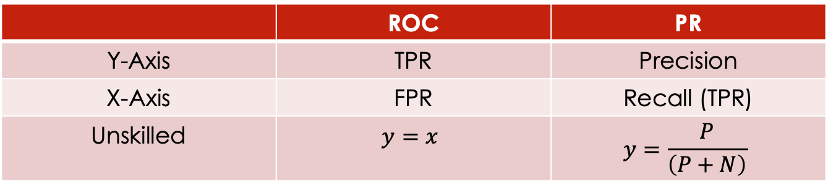
Receiver Operator Characteristic (Roc) Curve & Precision-Recall (pr) Curve
 | ROC | PR
Y-Axis | TPR | Precision
X-Axis | FPR | Recall (TPR)
Unskilled | $$y=x$$ | $$y=\frac{P}{\left(P+N\right)}$$
Increment Threshold Values
Amino Acid Residue Type & Position | Interface Prediction Score
a ⋮ b ⋮ c ⋮ d ⋮ z | 1 ⋮ 0.75 ⋮ 0.5 ⋮ 0.25 ⋮ 0
Both provide overview of the range of performance with varying thresholds
PR curves can illustrate performance differences between balanced and imbalanced data sets, while ROC curves cannot

Slide 17
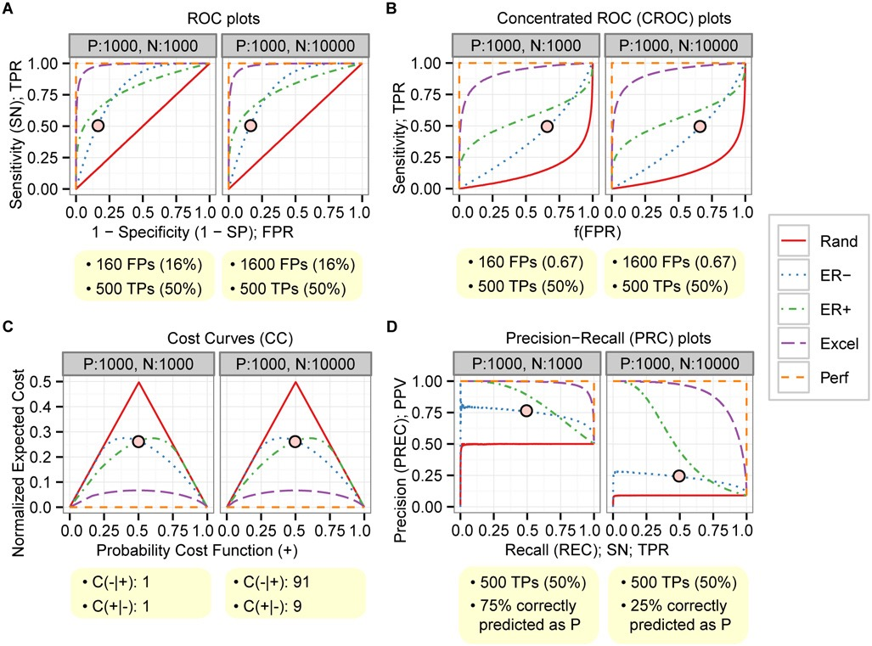
Imbalanced Data Sets: Roc Curve vs. pr Curve
Saito T, Rehmsmeier M (2015) The Precision-Recall Plot Is More Informative than the ROC Plot When Evaluating Binary Classifiers on Imbalanced Datasets. PLoS ONE 10(3): e0118432. doi:10.1371/journal.pone.0118432

Slide 18
Results: Roc Curve
Method | ROC_AUC
PredUs 2.0 | 0.743
ISPRED4 | 0.792
DockPred | 0.866
Meta-DPI | 0.871

Slide 19
Results: Roc Curve (metamethod comparison)
Method | ROC_AUC
PredUs 2.0 | 0.666
ISPRED4 | 0.815
DockPred | 0.761
Meta-DPI | 0.849
Method | ROC_AUC
Meta-DI | 0.844
Meta-DP | 0.760
Meta-PI | 0.826
Meta-DPI | 0.849

Slide 20
Results: pr Curve
Method | PR_AUC
PredUs 2.0 | 0.246
ISPRED4 | 0.263
DockPred | 0.288
Meta-DPI | 0.364

Slide 21
Results: pr Curve (Metamethod comparison)
Method | PR_AUC
PredUs 2.0 | 0.260
ISPRED4 | 0.359
DockPred | 0.264
Meta-DPI | 0.389
Method | PR_AUC
Meta-DI | 0.375
Meta-DP | 0.299
Meta-PI | 0.373
Meta-DPI | 0.389

Slide 22

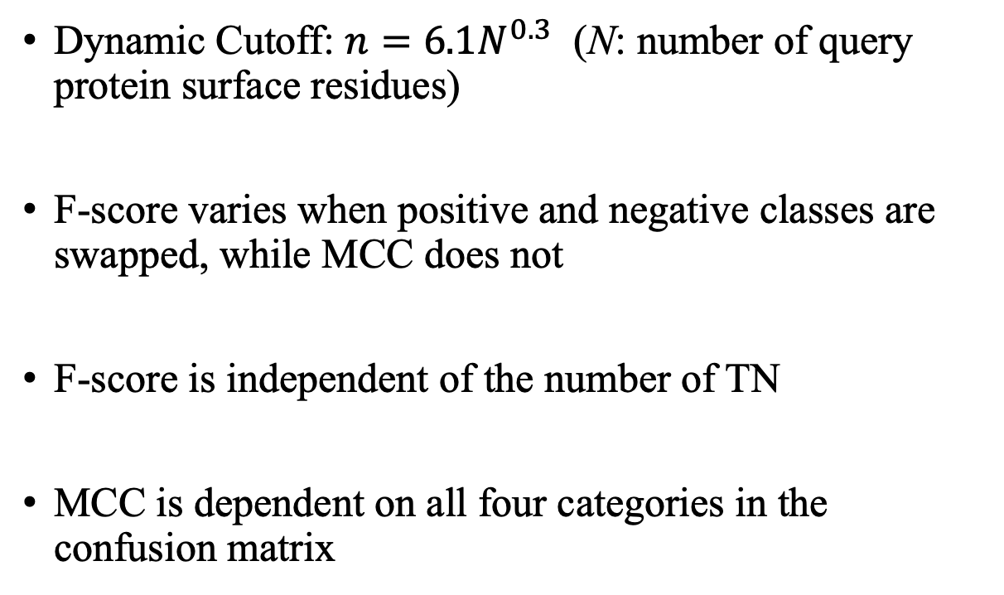
MCC & F-SCore
Dynamic Cutoff: $n=6.1N^{0.3}$ (N: number of query protein surface residues)
F-score varies when positive and negative classes are swapped, while MCC does not
F-score is independent of the number of TN
MCC is dependent on all four categories in the confusion matrix
Amino Acid Residue Type & Position | Interface Prediction Score
a ⋮ z | 1 ⋮ 0
$$n$$

Slide 23
Results: MCC & F-SCore
Method | Docking Benchmark F₁ Score | NOX F₁ Score | Docking Benchmark MCC | NOX MCC
PredUs 2.0 | 0.340 | 0.351 | 0.314 | 0.282
ISPRED4 | 0.342 | 0.400 | 0.316 | 0.336
DockPred | 0.375 | 0.361 | 0.355 | 0.293
Meta-DPI | 0.400 | 0.422 | 0.384 | 0.360
Method | Docking Benchmark F₁ Score | NOX F₁ Score | Docking Benchmark MCC | NOX MCC
Meta-DI | 0.391 | 0.418 | 0.373 | 0.356
Meta-DP | 0.398 | 0.378 | 0.382 | 0.311
Meta-PI | 0.367 | 0.418 | 0.346 | 0.356
Meta-DPI | 0.400 | 0.422 | 0.384 | 0.360

Slide 24
Summary
Meta-DPI integrates three orthologous prediction DockPred, PredUs 2.0, and ISPRED4
Performance of Meta-DPI is superior to individual methods by all performance metrics (F-Score, MCC, ROCAUC, PRAUC)
Similar results were obtained by inverting the training and test datasets
Next Step: Investigate how performance of meta-DPI relates to the classification of the query protein
Future Plan: Extend methodology to identifying antigen epitopes

Slide 25
Acknowledgements
I would like to convey my sincere gratitude to my research advisor, Professor Viswanathan. Her guidance and encouragement have been instrumental to the project’s success.
Special thanks to Evan Edelstein for helping write the logistic regression and data analysis scripts.

